Slide 1

Content Strategy of deshal Local Clothing Boutique(Dhaka)

Slide 2
Executive Summary
Deshal is a name of a dream created by three young artists of Bangladesh. It word “Deshal” means ‘Native’ which was established fifteen years ago.
Deshal’s strength is immense popularity due to its low cost and high quality. Its’ business is to B2C targeting the all ages of men, women, and children, especially the young Bangladeshi people who are students of colleges and universities.
Management has developed the following business objectives to guarantee that the company's aims are met:
To gain the targeted audiences’ attraction in their simple, trendy, Bangladeshi materials, crafts, ethnic color combination and design focusing on artistic patterns in the national and worldwide market.
Launching marketing efforts to extend the company's clothing line and grab 10% of the branded urban clothing market.
To provide the unique design and marketing plan throughout the year not only for seasonal based.
Deshal's marketing is very rich in comparison to the competitors in their social media campaigns highlighting various national events messaging and colors in cloths segmenting different age groups. They are using some traditional names or keywords to attract the people. for example, for women (25+ ages)-Protiti, Mouri, Dheera, Proma etc. for toddler girls-Phul, Kolmi, Aparajita and so on. They are using a third-party organization (SSLCommerze) to manage payment gateway transaction.
It's winter in Bangladesh and also the country is celebrating its 50th Victory Day this month. As a business promoting local tradition, they may incorporate victory themes in the design of their customized clothing, as well as focus on winter collections. In their content, few items are found that are old whereas their competitor Rang-Bangladesh offers a special content concerning the country's victory day entitled Bijoy (Victory) Collection'21 that is quite outstanding. On the other hand, another rival, Kay Kraft, launched a victory day collection that highlighted both victory and winter themes at the same time in their outfits, for example, they employ victory design in Jackets, Gifts & Souvenirs' products, and accessories.

Slide 3
Objectives of the content campaign
Objective
To gain the targeted audiences’ attraction in their simple, trendy, Bangladeshi materials, crafts, ethnic color combination and design focusing on artistic patterns in the national and worldwide market.
Tactics
Create one in-depth post every month to enhance traffic from long-tail keywords.
Use social media marketing to direct visitors to in-depth blog posts.
Objective
Launching marketing initiatives to expand the company's clothing line and capture 10% of the branded urban clothes market.
Tactics:
Make sure that the new products are available both in-store and in online search results.
Display nearby stores in Google Maps and Google Search.
Increase sales of upgrades and add-ons.
Promote their clothing to the customers in social media through a unique name like Jhinuk, Noyona, Bonophul, Benia and so on that is different from other competitors.
Objective
To provide the unique design and marketing plan throughout the year not only for seasonal based.
Tactics:
Increase the relationship with influencers (e.g., famous artists, fashion designers, etc.) in order to escalate the brand’s social media presence.
Recontact former consumers promoting the new product launch.
Displaying their new items featuring some tags like ‘New’ and ‘On sale’.
Request customer recommendations.
Objective
Launching marketing initiatives to expand the company's clothing line and capture 10% of the branded urban clothes market.
Tactics:
Make sure that the new products are available both in-store and in online search results.
Display nearby stores in Google Maps and Google Search.
Increase sales of upgrades and add-ons.
Promote their clothing to the customers in social media through a unique name like Jhinuk, Noyona, Bonophul, Benia and so on that is different from other competitors.

Slide 4
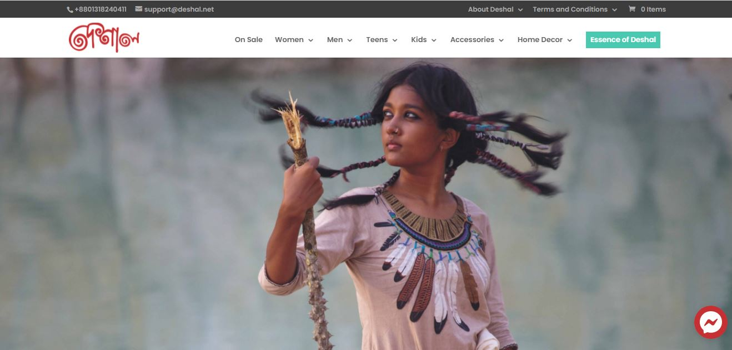
Content Audit listing of client’s current content Compare with Competitors
Content | Owned content | Non-Owned content
Deshal | Website, Paid Subscription | Social Media (Facebook, Instagram, Twitter, YouTube)
Kay Kraft | Website, Paid Subscription | Social Media (Facebook, Instagram, LinkedIn, YouTube)
Rang-Bangladesh | Website, Newsletter | Social Media (Facebook, , Instagram, Twitter, YouTube)

Slide 5
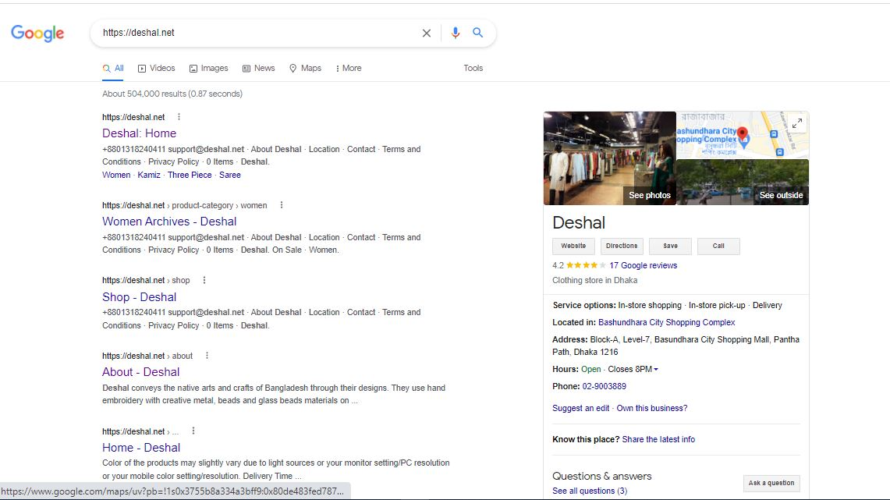
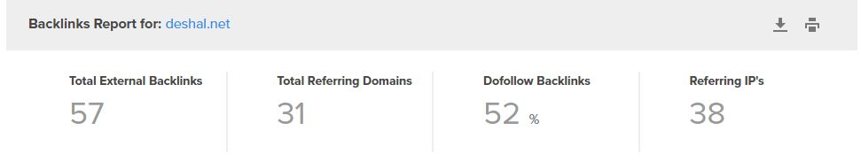
Owned Content

Slide 6
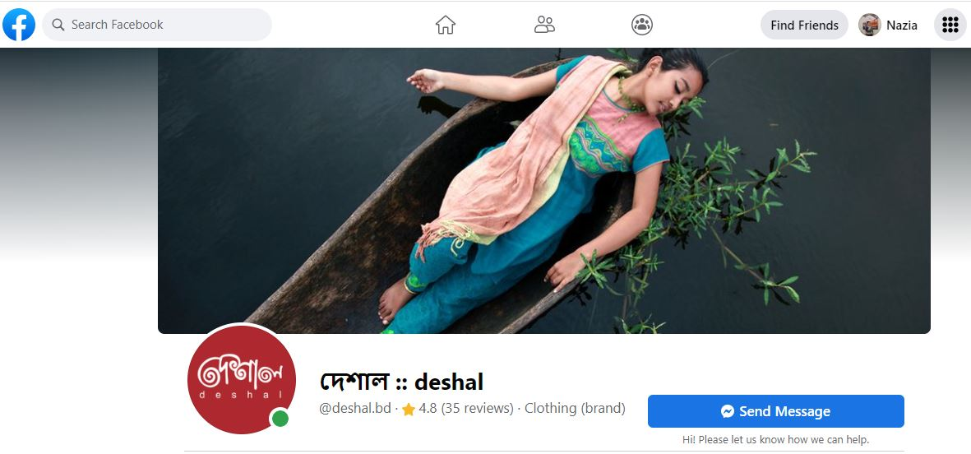
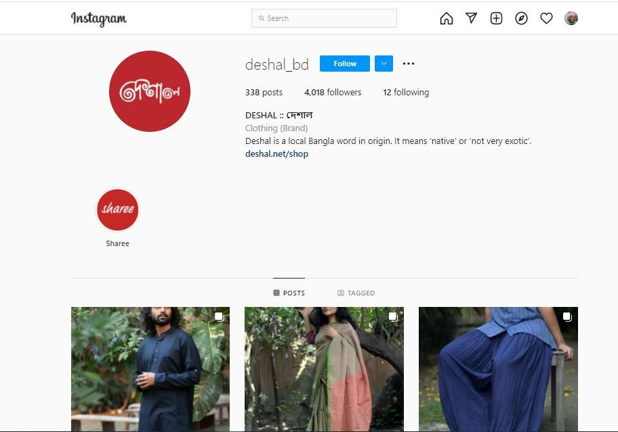
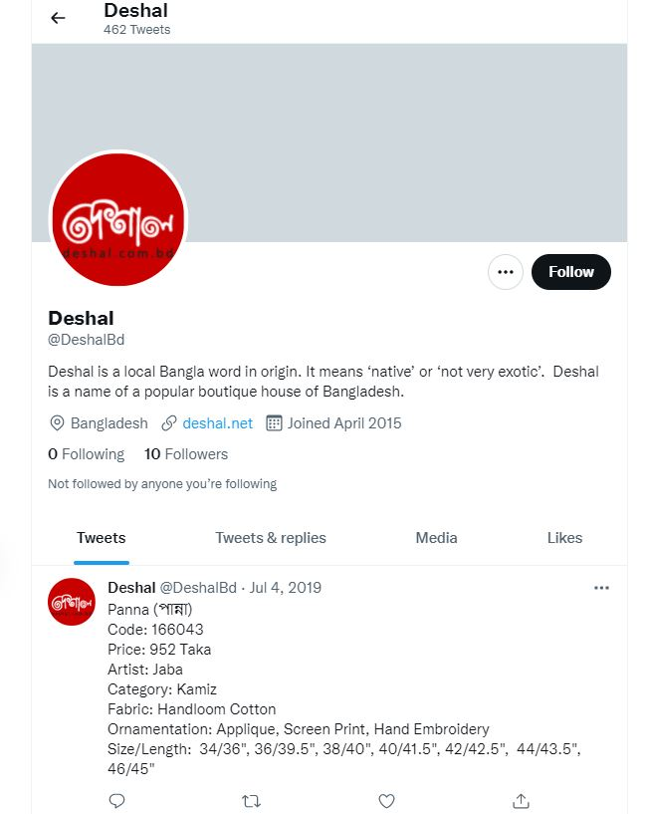
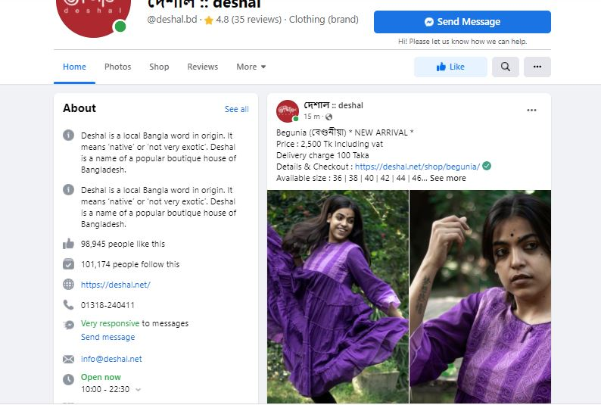
Non-owned content

Slide 7
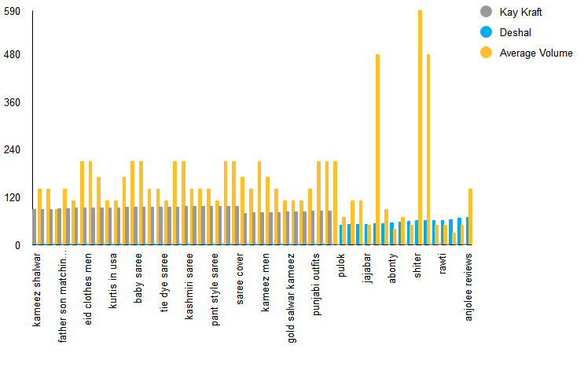
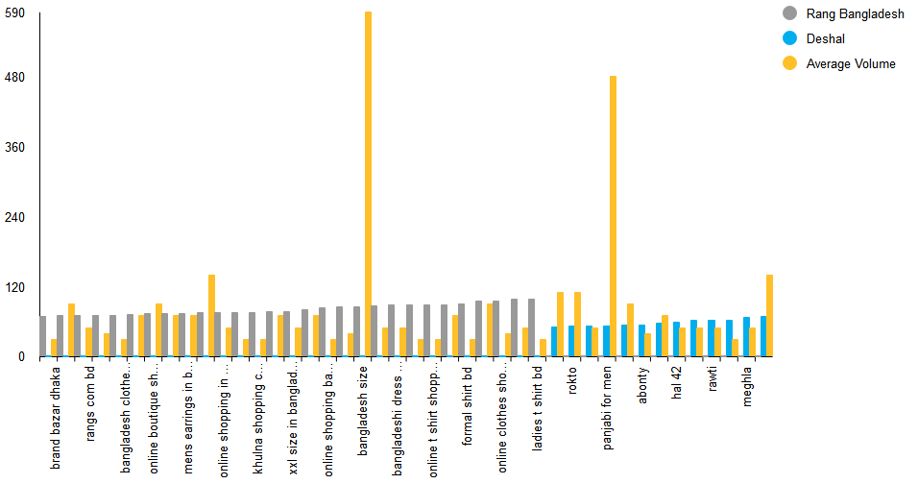
Content gaps
Two Competitors of Deshal
Kay Kraft
Rang Bangladesh
Kay Kraft & Deshal
Rang Bangladesh & Deshal

Slide 8
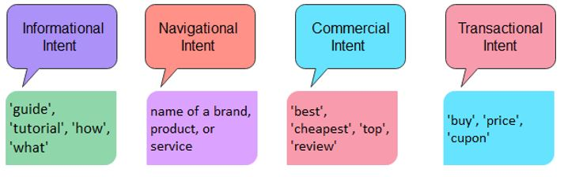
Opportunities for new content
Email newsletters Marketing to reconnect with the former and new customers.
Create more campaigns and increase engagement in WhatsApp, Twitter and LinkedIn like other competitors. They can include the platform of Reddit, Pinterest to boost the blogs.
Deshal has an opportunity to develop their own blogs and also articles that would be more effective for the customers.
Make a list of priority customers, who has a large number of websites visit and make a special campaign for them.
Change search intent and keywords into four categories; pay attention to the clue words in titles/headlines

Slide 9
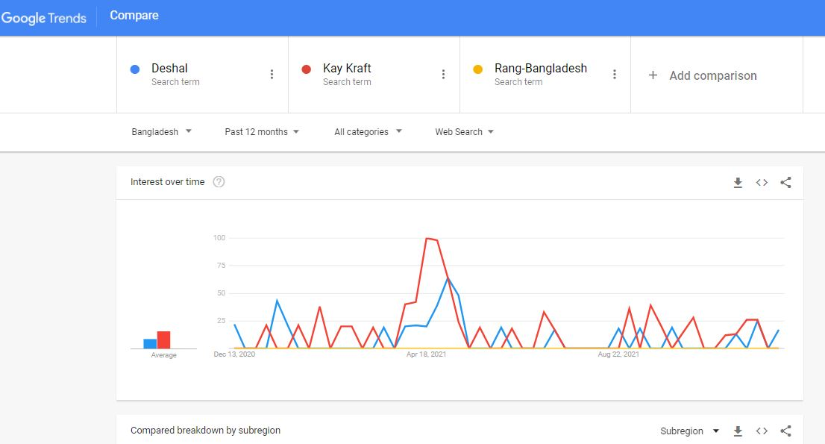
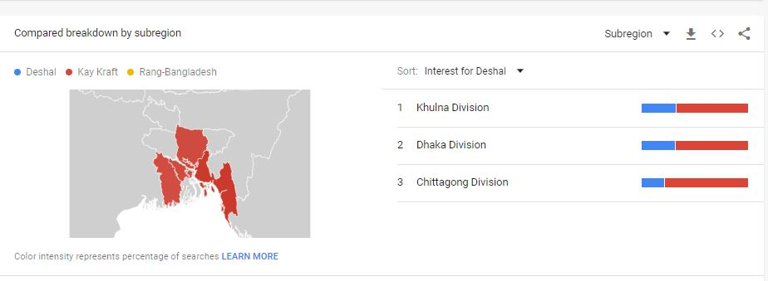
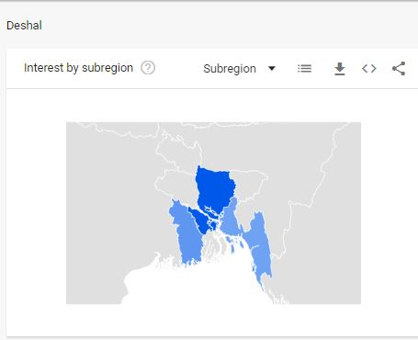
Content Ideation

Slide 10
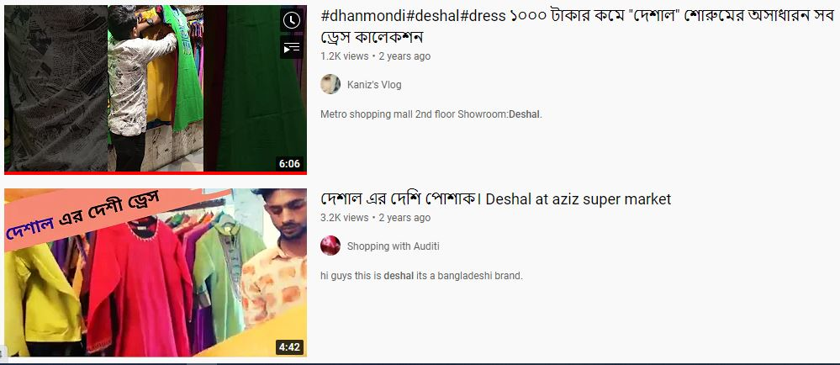

Slide 11
New content ideas Based on comparing with competitors
Keyword Phrase | SEO-Friendly Headline | Medium
Readymade | The best readymade dress for men and women | Blog post
Store near me | Nearby stores of the finest dress | Website
Sarees online USA | The best online sarees for all seasons in USA | Newsletter, Website, Podcast
Clothes men | The top brand for men’s cloths | Social Media
Wholesale sarees | The most beautiful wholesale sarees | Website, social media, Podcast
Online clothes shopping sites bd | The best online clothes shopping sites in bd | Blog post
Boys dress cloths | The best boys dress in the country | Newsletter, Blog post
Ladies t shirt bd | Ladies t shirt for all season in bd | Blog post, Website, podcast, social media

